Slide 1
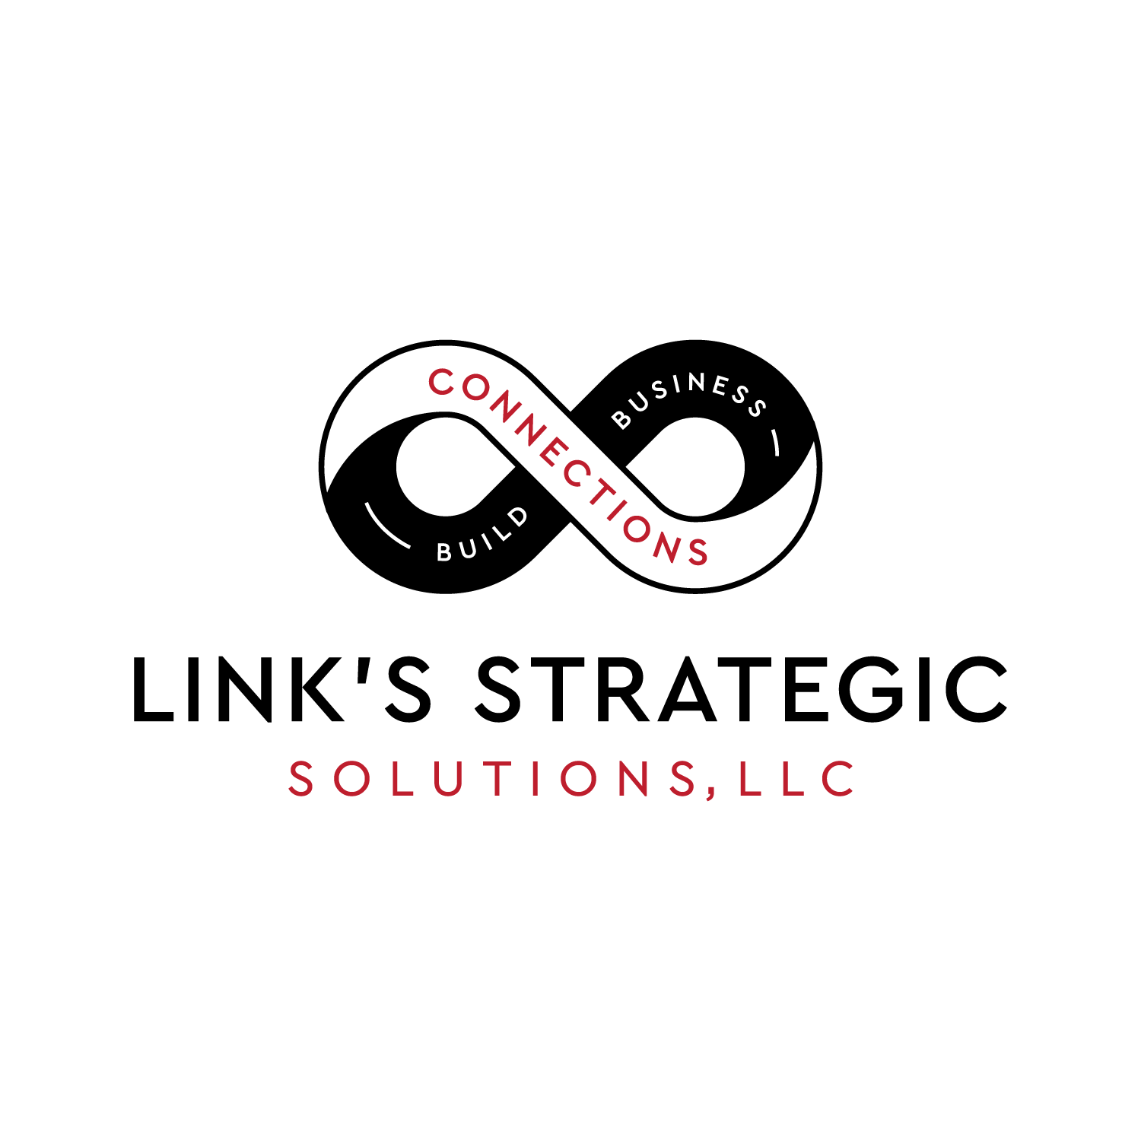
Helping businesses across the board

Slide 2
Case Studies
Asset Value
Planning
Efficiency
Promotion
Asset Utilization
Mental & Physical Health
Research
Market Analysis
Human Resources
Teamwork
Risk Analysis
Timing
Competition
Attention to Detail
Time Management
Recalls
Legalities
Hierarchical Organization
Procurement
Over Extension
Documentation
Hostile Takeover
Training
Climate
Ethics
Practice
Secrecy
Return on Investment
Role Alignment
Current Trends
Life-cycle
Strategic & Short-term Goals
Competitor Analysis
Market Testing
Communication

Slide 3
Wasted Dollars & Time
Tired of trendy & ineffective schemes?
Fancy videos full of fluff but not substance?
Overpriced speakers where audience sleeps through presentation?
Expensive bloated ‘packages’ YOU have to present?
‘Research Backed’ long term programs which smack of self-promoting?
People telling YOU how to run your business?

Slide 4
HARMONIOUS ACTIONS , UNIFIED & ATTAINED GOALS
Clear Objectives & Efficient Action Plans
Focused & Adaptive Divisions
Interoffice & inter-company synergy
Each office player interacts, and not reacts, to others producing active, dynamic and productive actions.
Offices that used to work ‘independently’ now work holistically as a unified team.
Following newfound astute, solid, and clear goals, all phases of the company generate higher returns, and decrease wastefulness, and costs.

Slide 5
UNITY HORIZONTALLY AND VERTICALLY
Cohesive & Strong Sales and marketing
Disciplined Management
Efficient Supply Chain
LEANER & MORE PROFITABLE COMPANY
Increased efficiency in and across all the departments now create stronger, adaptive, and organized divisions.
Effected positively are all divisions, plus higher awareness in operations, refined & responsive management, better prepared front end workers yielding more responsive customer service & satisfaction.
This leads to increased productivity thus higher profits and returns to shareholders.

Slide 6
Management Perspective
For Themselves
Coordination of participants.
Improved risk analysis
Better threat assessment
Clearer & more detailed long range strategy plans
More detailed short-range planning
Increased attention to detail
Tight focus yet big picture
For Employees
Employee belonging
Stress relief
Cognitive improvement
Attention to detail
Value of time
Improved logical adaptability
Increased efficiency
Higher self and situational awareness

Slide 7
Non-Management Perspective
For Themselves
Cohesive teaming
Communication
Networking
Appreciated
Improved decision making
Increased adaptive, out of box thinking
Better problem-solving skills
FUN
Towards Management
More insightful
Less wasteful
Caring
Involved
More active in improving employee skills, and work culture
Results orientated

Slide 8
CORPORATE BENEFITS
Increased efficiency of work-hours
(which has many positive implications)
Increased worker load capability
Decreased human error
(again, numerous positive resultant factors)
Streamlined corporate actions
Less ‘corrections’ (time & money) from not so desirable decisions
Less employee turnover
Higher skilled workforce
Decrease in safety violations/accidents
Bottom line
Less waste across the board, improved performance across the board yielding higher profits & happy clients

Slide 9


ACTIVE & FUN LEARNING
Active & fun participation will always outperform ‘sit-n-get’.
Association is a building block of building pathways to new discovery, problem solving and learning.

Slide 10
Ok, but why Link’s Strategic Solutions, LLC?
ITS ALL IN THE PRESENTER!
I know how to fluidly manage the environment while maximizing learning. This is a complex skill honed by decades of classroom teaching.
I employ teaching & learning strategies that are enjoyable, lively and present the whole package with a love of business along with a sincere commitment to the participants.
I understand various learning styles, multiple intelligences, and merge them with previous and new knowledge creating a dynamic, seamless, interactive and productive environment for all.
Training Expertise (22 years as secondary mathematics teacher)
Varied Business Background and Education
Chess Knowledge

Slide 11
Ok, but why Link’s Strategic Solutions, LLC?
ITS ALL IN THE PRESENTER!
10 years retail experience, incl. supervisory
2 years experience at store level management
8 years experience in military functions that encompassed managing maintenance functions of multi-million-dollar aircraft, and work with worldwide databases where details could mean mission success, and even life & death.
I hold two bachelors, a masters in MIS (‘MBA with technology involved’), and ABD in Ed.
Started up a couple of businesses: Grew chess instruction business 100% every year over 3 years.
Variety of business type experiences afford a very wide range of business strategy exposures.
Training Expertise (13 years as secondary mathematics teacher)
Varied Business Background and Education
Chess Knowledge

Slide 12
Ok, but why Link’s Strategic Solutions, LLC?
ITS ALL IN THE PRESENTER!
20+ years experience teaching chess
Coached a team to Kansas State Championship
Instructed chess for several park districts, and a private school
Started and presided over a civic chess club (Aurora Naperville Chess Club) that also participated in the CICL (Chicago Industrial Chess League)
With no ‘training’, compete in USCF sanctioned tournaments, with a class ‘C’ rating. Not a chess automaton. Ability to relate chess effectively to life, work, and home
Training Expertise (13 years as secondary mathematics teacher)
Varied Business Background and Education
Chess Knowledge
Notes:
Not an expert or master but still above 92% of players.

Slide 13
Link’s Strategic Solutions, LLC
Clearer, more effective communication across the company
Improved & refined problem solving
Enhanced alignment between goals & directives
Elevate team cohesion
Focused employees

Slide 14
web: LinksStrategicSolutions.com email: Darin@LinksStrategicSolutions.com
Ph: 316.244.7796

